Slide 1
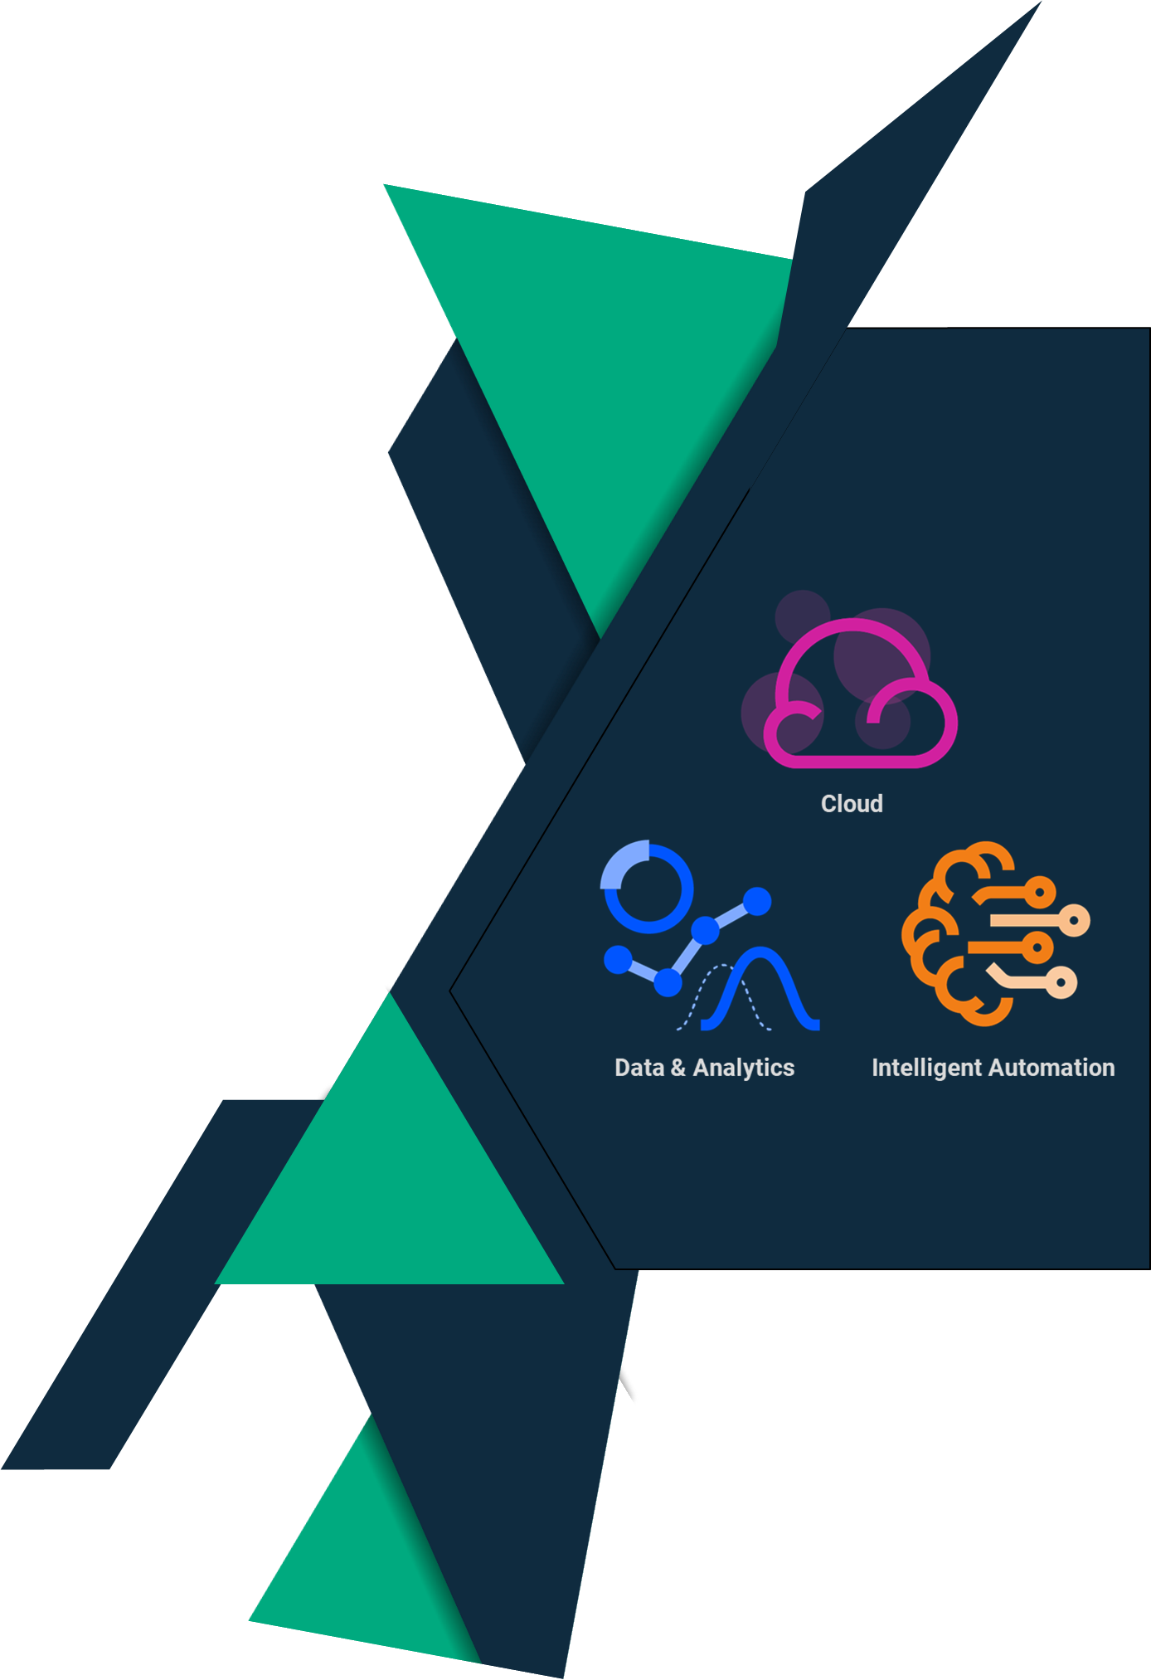


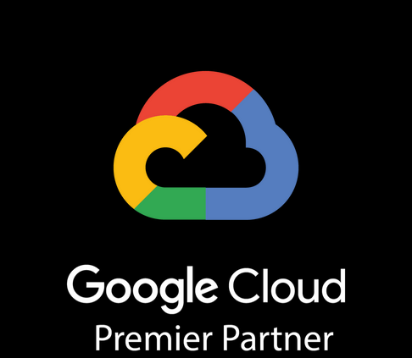
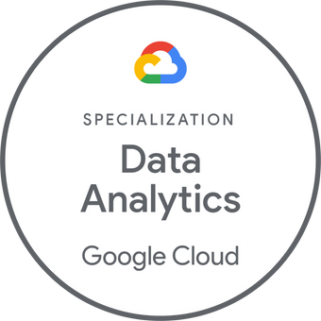

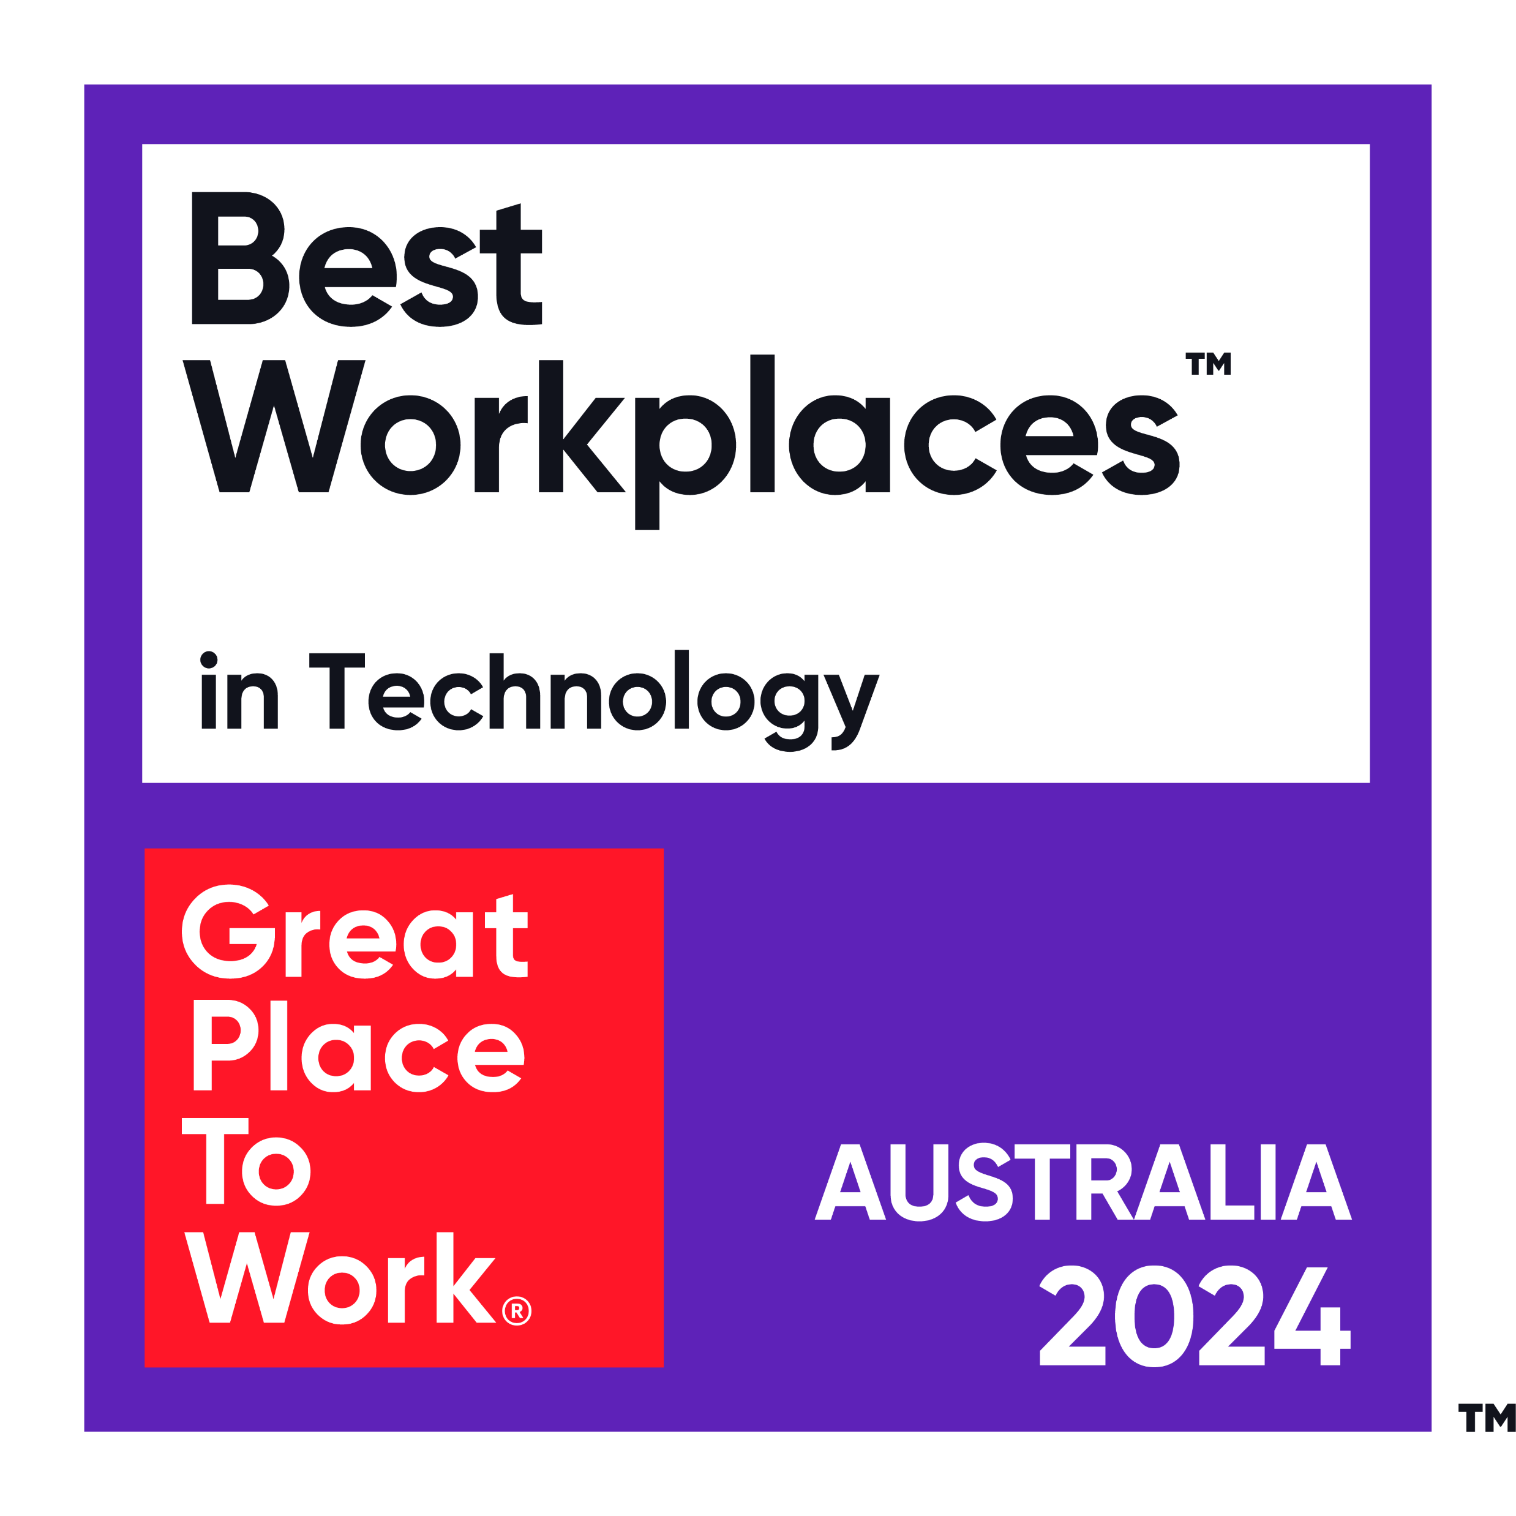


Prepared for:
August 2024
www.intelia.ai

Slide 2
Who is intelia
Premier Google Cloud partner, with accredited specialisation in Data & Analytics
We are a local & agile technology consultancy specialising in data analytics
First in region APAC partner of GenerativeAI powered Enterprise Search Platform – Glean.com
Unique partner eco-system – Google Cloud, Glean, Databricks, Tamr, Confluent, Collibra, C3.ai & Fivetran
Working with leading Australian Corporate and Enterprise customers to deliver and upskill – we aren’t a Managed Services provider so our aim is to enable your team to take forward our joint solutions
We have a Culture-first approach, and were recently voted #11 in GPTW
We only do Data
Data Analytics & ML Specialists
Automated ingestion, Next-gen data warehousing, GenAI, MLOps
Partnership Approach
Partnership approach with our customers
Deep relationships, trusted High touch, strategic alignment with enterprise programs and strategies
Multiple engagement approaches from specialist skills to strategic delivery and outcomes-based
100+ Professional Cloud Certifications
Cloud architecture, data engineering, AI/ML, security and software development
Dedicated Partner & Solutions Team
Chief Technologist & Data Practice Lead building cross platform capability
End to end data solutions encompassing data acquisition and storage, integration and consumption as well as implementing advanced analytics solutions
We are proudly Australian Owned and Operated located in Melbourne, Sydney, Brisbane and Darwin

Slide 3




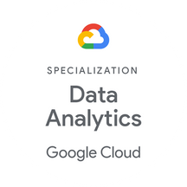














we are
Partner with intelia to unlock the power of your data and propel your business forward
#delightthecustomer
Our customers' success is the core to our success – we deliver what we commit to with precision, innovation and care.
#beauthentic
Australian-owned and operated agile technology consultancy
Leveraging a world-class partner ecosystem to supercharge your business growth
Secure, automated solutions keep your data safe and empower informed decision-making
Bring your entire self to work – be quirky, be fun, be confident and most importantly be yourself. We are an open, transparent, no bullshit organisation. Our clients love us for this.
#proudlypassionate
We spend an enormous amount of time at work – it’s important we work in an environment where we are proud of what we do, care about our delivery and enjoy ourselves. Share the passion to appreciate the opportunities that life has presented.
Enhanced governance ensures you're ready to capitalise on the opportunities and navigate the disruptions of AI
Proven end to end experience and capability in successfully planning and delivering data programs and projects across multiple industries
#constantlyevolve
Never stand still – a progressive organisation can only be successful if we’re committed to getting better. Be open to new challenges, do things differently and learning from our experiences.
#onetribe
We understand that so much
more can be achieved as a team. Embrace each other, the diversity in our thinking, experiences, skills and culture. Celebrate the successes, laugh and support each other in the challenging times.
Combining local expertise with global reach
We're a nimble team of data enthusiasts, passionate about helping you succeed in the AI age
Our culture-first approach prioritises understanding your needs and building a strong partnership
www.intelia.ai

Slide 4




What we do
DATA & ANALYTICS
Architecture & Security
Engineering & Ingestion
Integration & API Development
Visualisation & Dashboards
Advanced Analytics
INTELLIGENT AUTOMATION:
Automation Strategy
Business & Robotic Process Automation
Predictive Analytics
AI & ML
Customer Engagement Automation & Chatbots
AI – Enterprise Platforms
Generative AI
CLOUD
Architecture & Design
Data & Application Migration
Security & Identity Management
Infrastructure Automation & DevOps
Container & Serverless Solutions
Cloud Data Warehousing
“Data fuels amazing applications, and helps businesses compete”
— Google Cloud
Ongoing commitment to accelerate our customers strategic initiatives and deliver a seamless transition process that fosters customer satisfaction and long-term partnerships.
Providing market leading data platforms to enterprise GCP clients in region
Pureplay GCP Cloud partner with data focus
Market-leading partner eco-system
High touch, strategic alignment with enterprise programs
Partner-aligned delivery – world first custom integrations built into partner tech stack including GCP & Collibra
Specialist Looker reseller and implementation partner
intelia.com.au

Slide 5









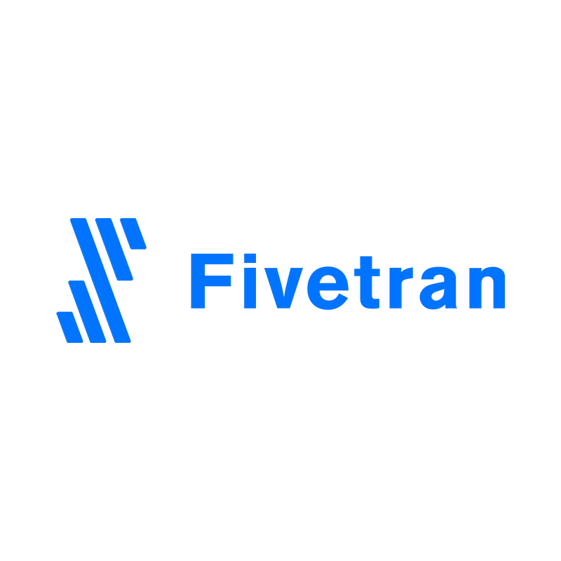

Partner eco-system
Our partner ecosystem is focused on best of breed technology solutions who add agility, scale and maintainability to our client environments.
Partners fall into 3 specific groups:
Primary partners:
Executive-level relationships
Joint Go to Market Strategy (including multiple partner alignment)
Sales Planning – including joint sales cadence
Formal certification and KPI alignment (both technical and sales)
Marketing Events
Secondary Partners
Formal Partnership in place
Sales planning – key accounts only
Core certification (limited number of sales and technical presales certification)
Tertiary Partners
Technical capability and use case validation
High level delivery patterns in data ecosystem
Primary Partners
Secondary Partners
Tertiary Partners
intelia.com.au

Slide 6
How does intelia approach delivery?

Slide 7
Our Delivery Approach
Our customer’s success is the core to our success. We deliver what we promise with precision, innovation, quality and care.
When it comes to an overarching delivery framework, we believe in keeping things simple, clear and elevated beyond complexity.
We ensure absolute clarity and agreement on seven key elements which become our shared “true North”.
WHAT: BUSINESS DRIVERS, REQUIREMENTS & CONSTRAINTS:
What is the problem you're trying to solve / opportunity you’re trying to take advantage of (business drivers), what are the defined requirements​ and what are the constraints within which we need to work (eg time, budget, regulations, known issues)
WHAT
SUCCESS MEASURES
SUCCESS MEASURES:
GOVERNANCE
What does success look like when we’re done (desired outcomes / objectives, quality measures, benefits)​
DELIVERY SUCCESS ENABLERS
WHEN:
When you need to have it done (deadlines / milestones / schedule)​
HOW:
WHO
WHEN
How we’re going to get it done (designs, plans, technology)​
WHO:
Who needs to be involved, roles / responsibilities (our team / your team / third parties)​
HOW
GOVERNANCE:
How we’re going to govern, communicate, monitor & report (meetings & cadence, reporting, dependency, issue, risk & change management)​

Slide 8
Our Delivery Approach
Our customer’s success is the core to our success – we deliver what we commit to with precision, innovation and care.
On every engagement, our defined approach to delivery is a focus on ensuring we clearly understand​:
What it is you’re asking us to do (requirements)​
What success looks like when we’re done (outcomes / objectives, quality requirements)​
When you need to have it done (deadlines / milestones / schedule)​
How we’re going to get it done (designs, plans, technology etc)​
Who needs to be involved to get it done, roles and responsibilities (our team / your team / 3rd parties)​
What our constraints are (budget, regulations, commercial, known issues etc)​
How we’re going to govern and communicate (meetings, reporting, issue and risk management etc)​
So that we design and deliver a working solution that adds value and meets your business needs
intelia.com.au

Slide 9

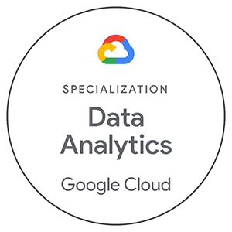




intelia Data Solution Delivery
Data Services Supporting the Bendigo & Adelaide Bank Data Journey
Use Case
Definition
Data
Governance
Platform & Technical Architecture
Data Solution Delivery
Advanced
Analytics
Business Engagement
Use Case Validation
Solution Scoping
Requirements Analysis
Business Analysts
Technical Analysts
Principal Consultants
Project Delivery
Operating Model Dev
Data Domain Definition
Glossary & Catalogue
Data Lineage & Quality
Data Governance Consultants
Technical Analysts
Integration Developers
Platform & Solution Development
Vendor Analysis
E2E Architecture
Enterprise Architects
Solution Architects
Solution Designers
Data Architects
Data Pipeline Dev
Data Modelling
API Development
Reporting Solutions
Integration Engineers
Data Modellers
BI Developers
IAM & Security Engineers
Predictive Analytics
Sentiment Analysis
Geospatial Analysis
Customer Churn
Machine Learning Engineers
Technical Analysts
AI Ops Model Devs
www.intelia.com.au

Slide 10
Our Roles & Energy Experts

Slide 11


Technical Roles
Our consultants are experts in and can fulfil the following roles within your organisation;
Engineering
Delivery
Data Architects
Data Engineers
Solution Architects
Data Visualisation
Software Engineers
Data Modelers
Developers
Testers
Delivery Managers
Project Managers
Business Analysts
Change Managers
Tech Business Analysts
Data Analysts
Scrum Masters
Reporting Analysts

Slide 12
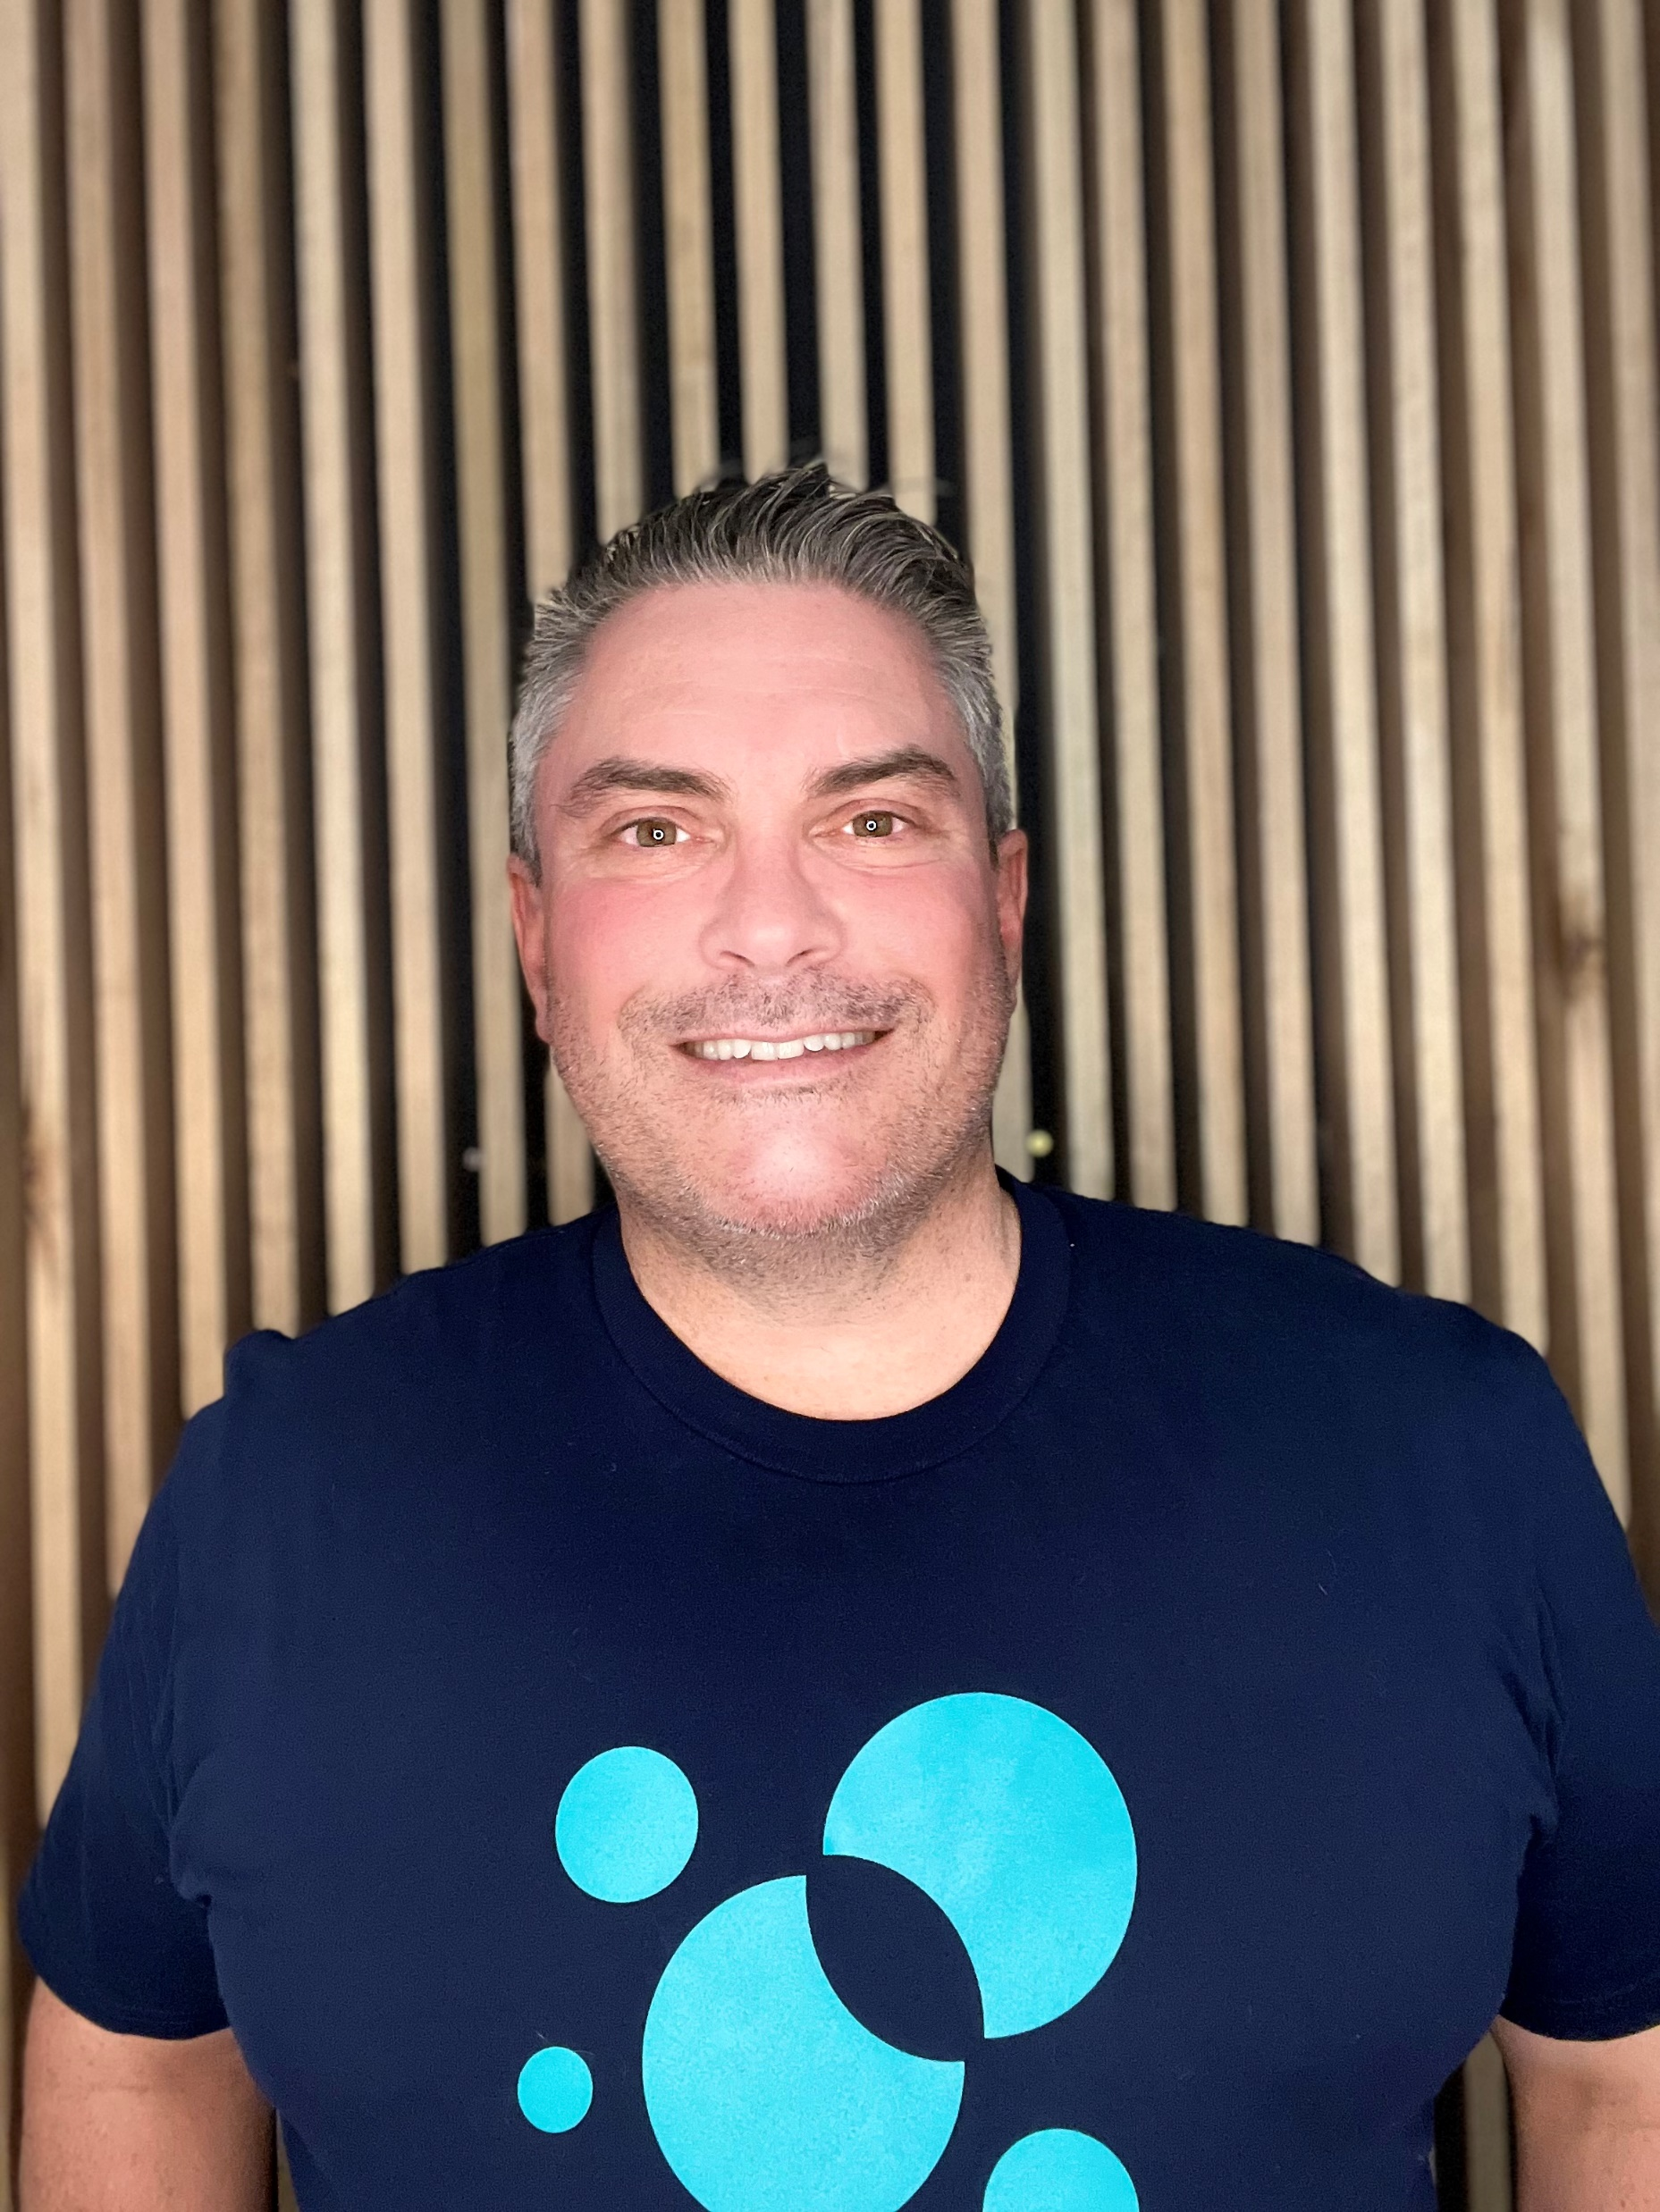
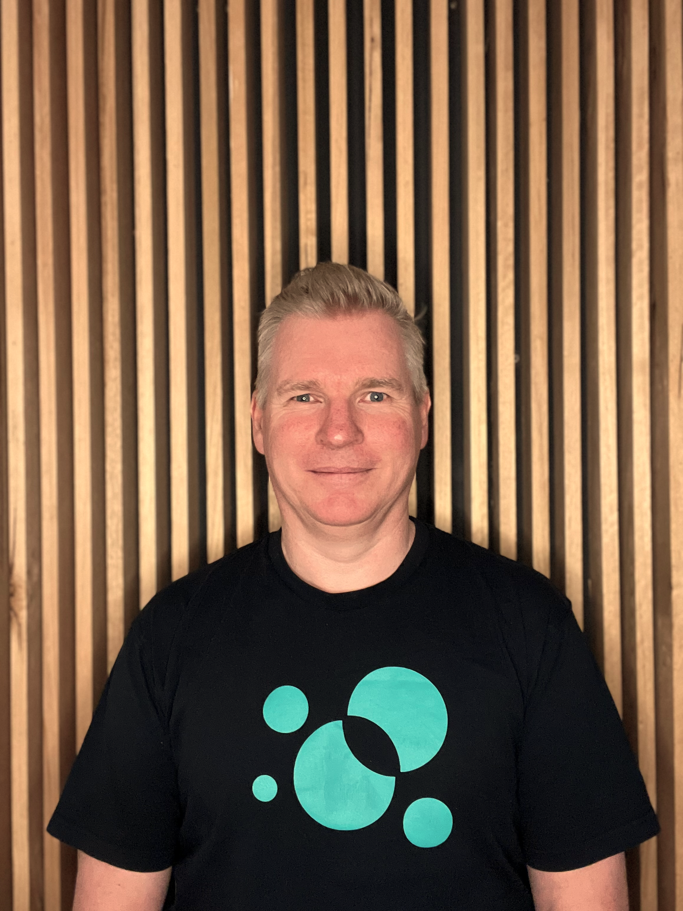

Consultant Summaries
Andrew Nisbett
Head of Delivery
Andrew is the head of delivery at intelia, holding over 30 years' experience spanning multiple industries including Energy, Fast-moving Consumer Goods, Agriculture, Banking, Telecommunications, Directory Services / Advertising and Government. Andrew has extensive experience in defining, initiating, planning, governing, managing and successfully delivering end-to-end projects.​ An effective communicator, Andrew is pragmatic and practical in leading, managing and working with teams to find a way to deliver successful outcomes that add genuine business value and ensure business investment in IT is not a wasted endeavour.
Simon Masters
Principal Business Analyst / Strategist
Simon is a Principal Consultant at intelia, with a wealth of experience in business analysis, project management, software development and application support. Simon possesses strong business acumen, and a genuine desire to resolve not only the “how” but the “why”. Adept in building meaningful stakeholder partnerships, Simon conducts alignment between business and IT stakeholders, allowing problems to be solved and business needs to be met.

Slide 13
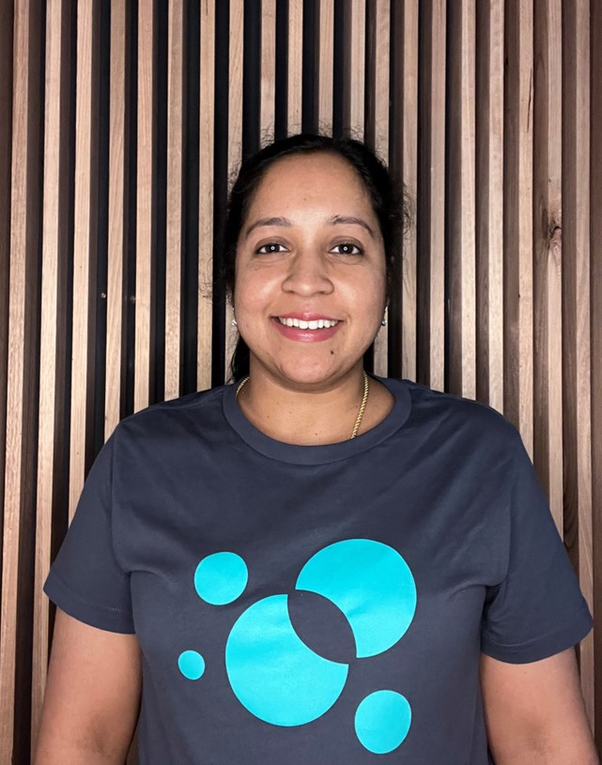
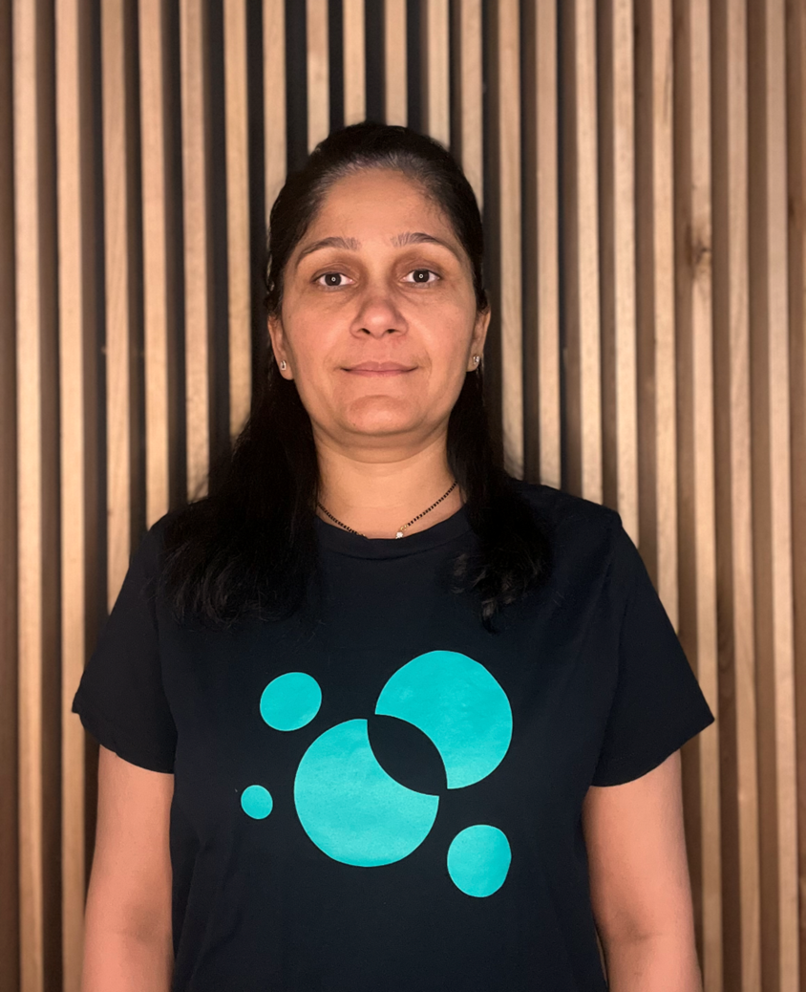
Consultant Summaries
Radhika Ramachandran
Senior Data Engineer
Radhika is a Data Engineer with vast experience and expertise in the Energy, Education, Banking, Health Insurance and Retail sectors. Radhika has proven experience in Azure Cloud, Big Data Solutions, Data Warehousing, Business Intelligence (ETL, Reporting) and Analytics. Highly skilled in using visualisation tools like Power BI, Radhika has extensive experience in developing, testing, and deploying code to high standards across various programming environments.
Vilas Patel
Principal Business Analyst
Vilas is a Principal Consultant at intelia. A seasoned Project / Program Manager and Scrum Master, Vilas has over 17 years of IT experience. Possessing a great blend of technology (Azure, DevOps, AEM) and management experience, Vilas has strong Domain knowledge across Energy, Telecom and Utilities. Working for various organisations globally across the USA, UK and APAC region, Vilas is practised across multiple industry verticals, delivering end-to-end programs achieving quality output.

Slide 14

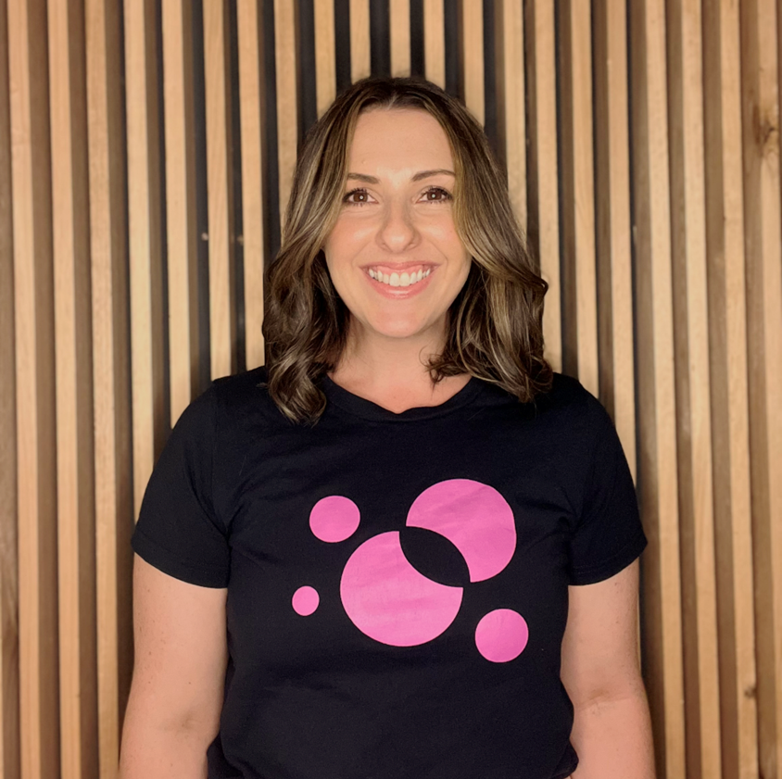
Consultant Summaries
Aungshu Barman
Senior Data Engineer
Aungshu is a Senior Consultant at intelia. An experienced technology professional, Aungshu specialises in database engineering and management, data warehousing, data staging, ETL/ ELT, visualisation and performance tuning, across project delivery, BAU and support. An expert in developing end-to-end analytics solutions, Aungshu builds fault-tolerant data pipelines from heterogeneous sources and develops analytical reports/dashboards enabling effective decision-making.
Erin Veitch
Senior Business Analyst
Erin is a Senior Consultant at intelia, an experienced Business Analyst with a passion for technology and a keen interest in AI/ML. Erin strives to be at the forefront of leading change through the evolution of robotic process automation in the workplace. Erin's strengths lie in designing people-centred business solutions, facilitation and communication. Erin has know-how in Data Analysis, Data Modelling, Design, Development and Implementation of Data Warehouse and Data Migration in the Banking, Insurance, Telecom and Retail Domains.

Slide 15




Energy Clients

Slide 16




www.intelia.ai
Case Study – API Led Transformation
Data Analytics
Architecture & security
Engineering & ingestion
Cloud
Architecture & design
Cloud infrastructure implementation
Infrastructure automation & DevOps
Cloud data store
Problem
Solution
Over the past year, there were many notable power system and market events that required large amounts of contingency Frequency Control Ancillary Services (FCAS) or energy-only responses. A large energy market company needed to analyse these data to draw insights on how the VPPs are interacting with the power system. VPPs need to integrate with the client’s system using VPP Demonstrations APIs and send required large volume of data real-time for analysis.
The client embarked on the establishment of a new application programming interface (API) management platform with the launch of the VPP Demonstrations. This required establishing patterns for the multi-cloud integration for the first time.
intelia, a key development partner for this client has also developed its systems to receive operational data from VPPs that provides visibility of the distribution connected distributed energy resource (DER) to the business. This helps the client learn how to integrate VPPs into the market at scale, which then inform appropriate regulatory and operational changes.
intelia’s Approach
intelia worked with the client to formalise, design and develop these API specifications into a scalable, cloud-based platform. This involved standing up a scrum team made up of a scrum master, three integration engineers and two automation testers supported by a solution architect.
This team would be the first to deliver a solution into production using an Agile approach for this client.
Outcome
Australian Energy Market Operator (AEMO)
AEMO, manages electricity and gas systems and markets
across Australia, helping to ensure Australians have access to affordable, secure and reliable energy.
Within the first few months of a yearlong trial program:
Registered VPPs are able to transfer terabytes of real-time operational and forecast data for the first time using the APIs
Significantly improved the client’s capability to draw insights on how VPPs are interacting with the power system
By participating in the contingency FCAS markets using the APIs, VPPs were able to earn substantial revenue in a short period of time
“intelia’s team were fantastic, details like a breakdown of your funding while others, like your trustees, will be more interested in the challenges you encountered and the lessons you learned from them."
- Tim Hewitt, Head of Data Services
With offices in Melbourne and Sydney, intelia is a technology consultancy specializing in all things data (strategy, architecture, governance, analytics, modern cloud data platforms and intelligent automation)

Slide 17

www.intelia.ai
Case Study – AI/ML
Data Analytics
Architecture & security
Engineering & ingestion
Cloud
Architecture & design
Cloud infrastructure implementation
Infrastructure automation & DevOps
Cloud data store
Problem
Solution
Over the past year, there were many notable power system and market events that required large amounts of contingency Frequency Control Ancillary Services (FCAS) or energy-only responses. A large energy market company needed to analyse these data to draw insights on how the VPPs are interacting with the power system. VPPs need to integrate with the client’s system using VPP Demonstrations APIs and send required large volume of data real-time for analysis.
The client embarked on the establishment of a new application programming interface (API) management platform with the launch of the VPP Demonstrations. This required establishing patterns for the multi-cloud integration for the first time.
intelia, a key development partner for this client has also developed its systems to receive operational data from VPPs that provides visibility of the distribution connected distributed energy resource (DER) to the business. This helps the client learn how to integrate VPPs into the market at scale, which then inform appropriate regulatory and operational changes.
intelia’s Approach
intelia worked with the client to formalise, design and develop these API specifications into a scalable, cloud-based platform. This involved standing up a scrum team made up of a scrum master, three integration engineers and two automation testers supported by a solution architect.
This team would be the first to deliver a solution into production using an Agile approach for this client.
Outcome
Australian Energy Market Operator (AEMO)
AEMO, manages electricity and gas systems and markets
across Australia, helping to ensure Australians have access to affordable, secure and reliable energy.
Within the first few months of a yearlong trial program:
Registered VPPs are able to transfer terabytes of real-time operational and forecast data for the first time using the APIs
Significantly improved the client’s capability to draw insights on how VPPs are interacting with the power system
By participating in the contingency FCAS markets using the APIs, VPPs were able to earn substantial revenue in a short period of time
“intelia’s team were fantastic, details like a breakdown of your funding while others, like your trustees, will be more interested in the challenges you encountered and the lessons you learned from them."
- Tim Hewat, Head of Data Services
With offices in Melbourne and Sydney, intelia is a technology consultancy specializing in all things data (strategy, architecture, governance, analytics, modern cloud data platforms and intelligent automation)

Slide 18
Case Study – API Data Migration (Federal Government)
Data Analytics
Data Architecture & Security
Engineering & Ingestion
Data Migration
Cloud
Architecture & Design
Cloud Infrastructure Implementation
Infrastructure Automation & DevOps
Cloud Data Store
Problem
Solution
Over the past year, there were many notable power system and market events that required large amounts of contingency Frequency Control Ancillary Services (FCAS) or energy-only responses. A large energy market company needed to analyse these data to draw insights on how the VPPs are interacting with the power system. VPPs need to integrate with the client’s system using VPP Demonstrations APIs and send required large volume of data real-time for analysis.
The client embarked on the establishment of a new application programming interface (API) management platform with the launch of the VPP Demonstrations. This required establishing patterns for the multi-cloud integration for the first time.
intelia, a key development partner for this client has also developed its systems to receive operational data from VPPs that provides visibility of the distribution connected distributed energy resource (DER) to the business. This helps the client learn how to integrate VPPs into the market at scale, which then inform appropriate regulatory and operational changes.
intelia’s Approach
intelia worked with the client to formalise, design and develop these API specifications into a scalable, cloud-based platform. This involved standing up a scrum team made up of a scrum master, three integration engineers and two automation testers supported by a solution architect.
This team would be the first to deliver a solution into production using an Agile approach for this client.
Outcome
National Energy Market Operator
Responsible for managing electricity and gas systems and markets
across Australia, helping to ensure Australians have access to affordable, secure and reliable energy.
Within the first few months of a yearlong trial program:
Registered VPPs are able to transfer terabytes of real-time operational and forecast data for the first time using the APIs
Significantly improved the client’s capability to draw insights on how VPPs are interacting with the power system
By participating in the contingency FCAS markets using the APIs, VPPs were able to earn substantial revenue in a short period of time
“intelia’s team were fantastic, details like a breakdown of your funding while others, like your trustees, will be more interested in the challenges you encountered and the lessons you learned from them."
With offices in Melbourne and Sydney, intelia is a technology consultancy specializing in all things data (strategy, architecture, governance, analytics, modern cloud data platforms and intelligent automation)
- Tim Hewat, Head of Data Services

